Slide 1
First finding of Skills and Jobs analysis for Kazakhstan
Sept 14th, 2020

Slide 2
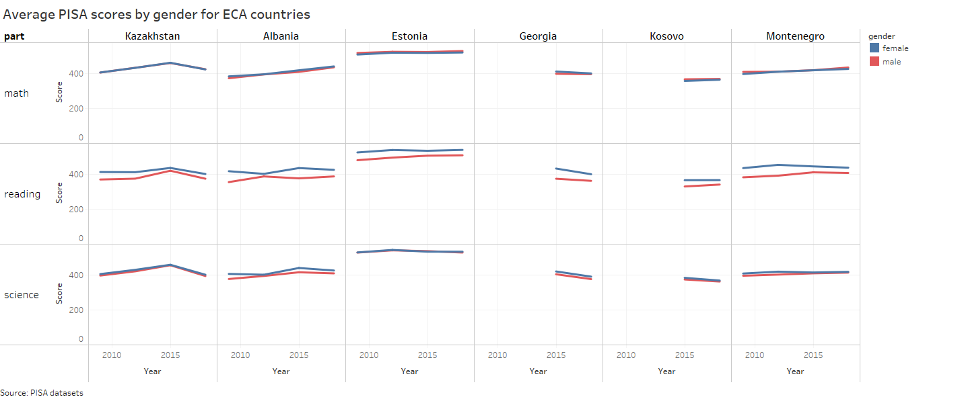
The gender gap in PISA

Slide 3
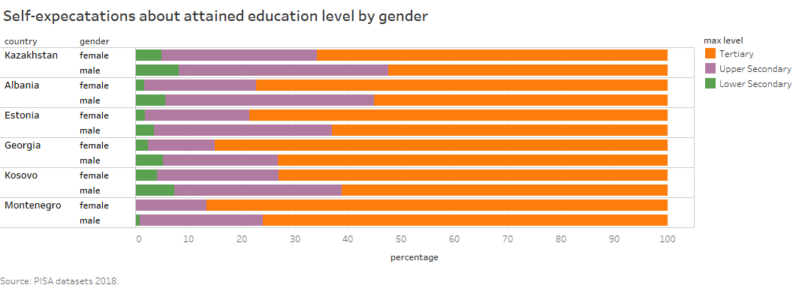
The gender gap in self-expectations

Slide 4
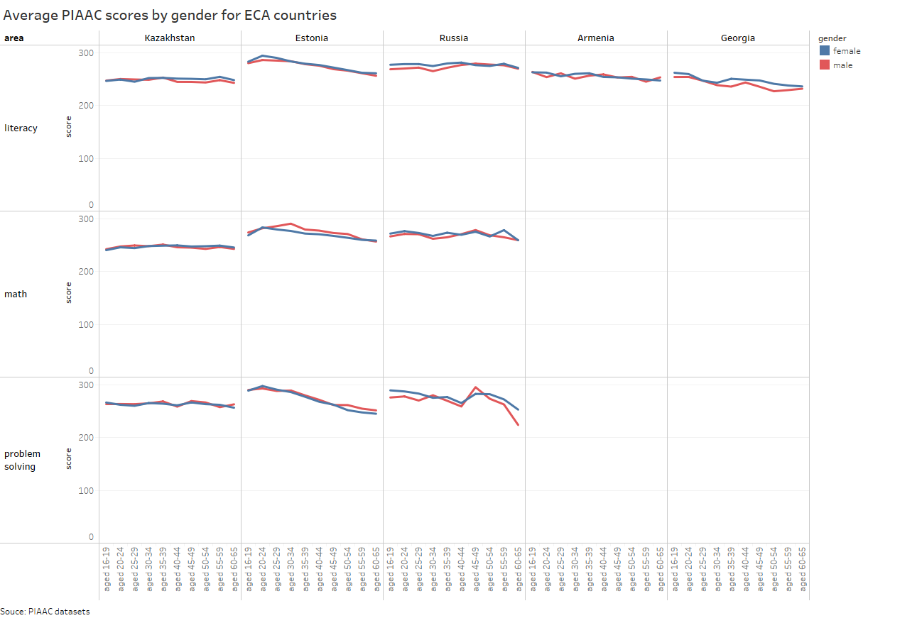
The gender gap in PIAAC

Slide 5
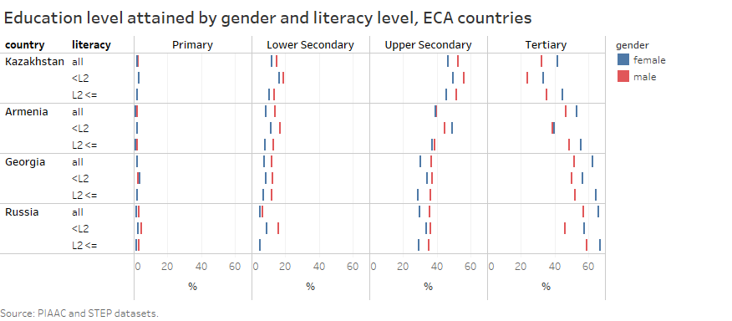
Is there a gender penalty in education?

Slide 6
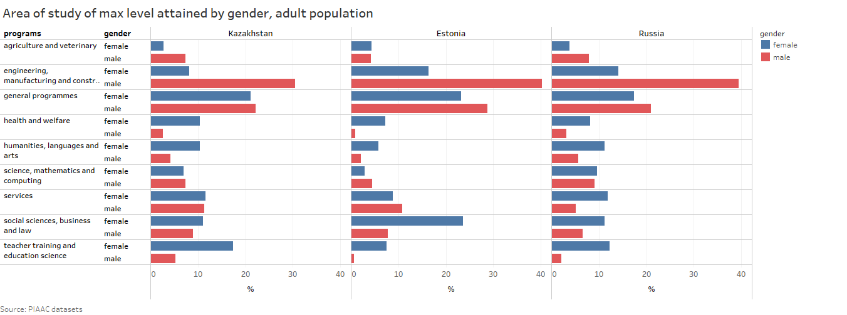
Is there a gender division of areas of study?

Slide 7
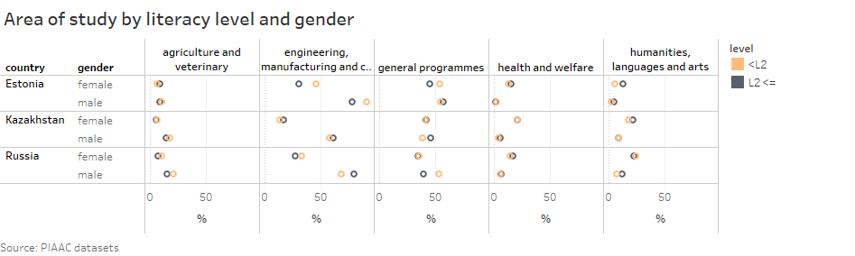
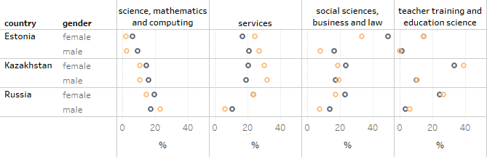
Are people with different skill profiles allocating in different areas of study?

Slide 8
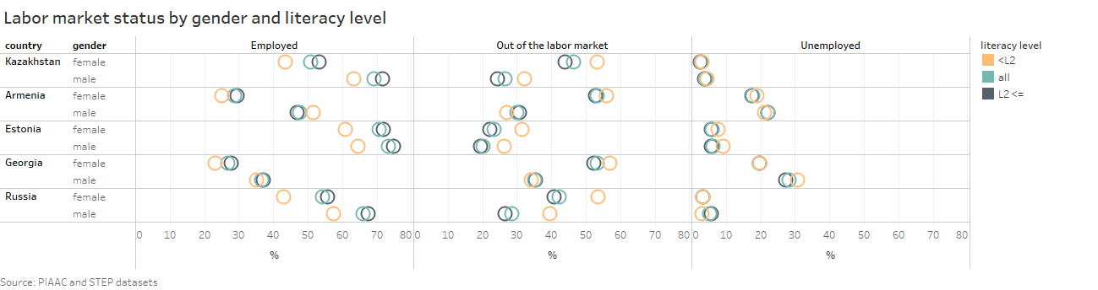
Are there gender differences in labor status?

Slide 9
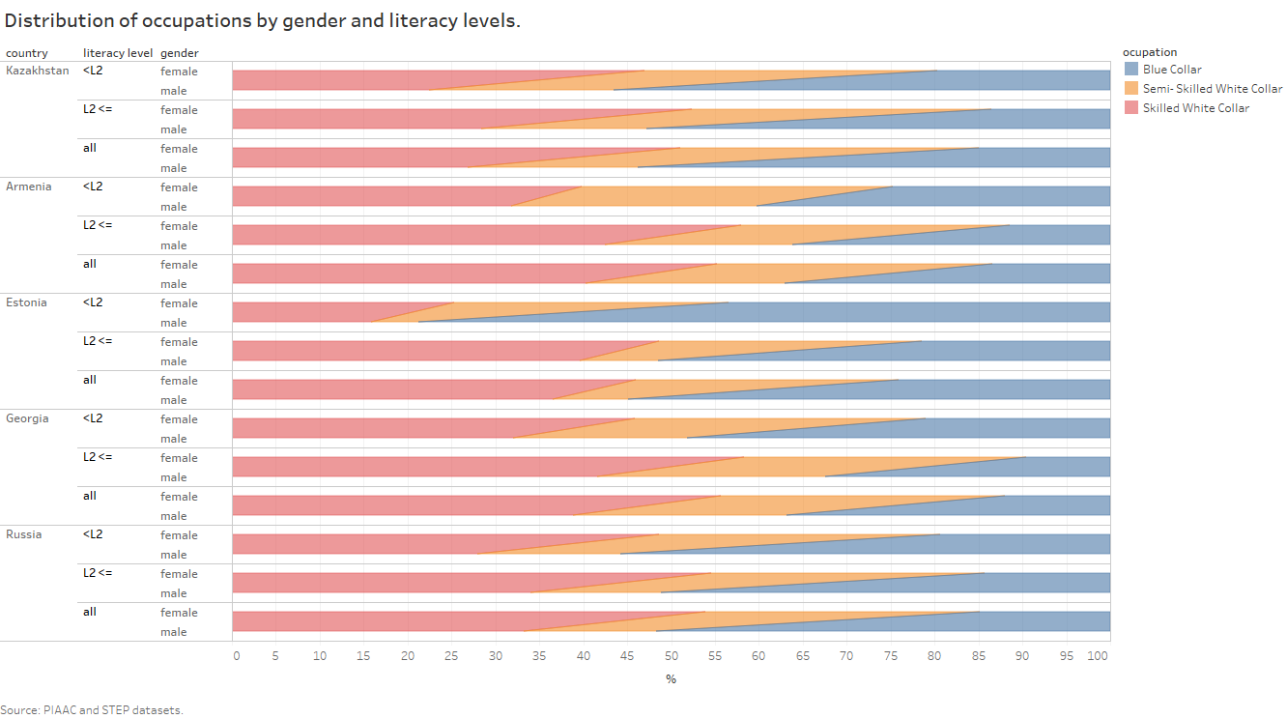
Gender differences in occupations

